Slide 1
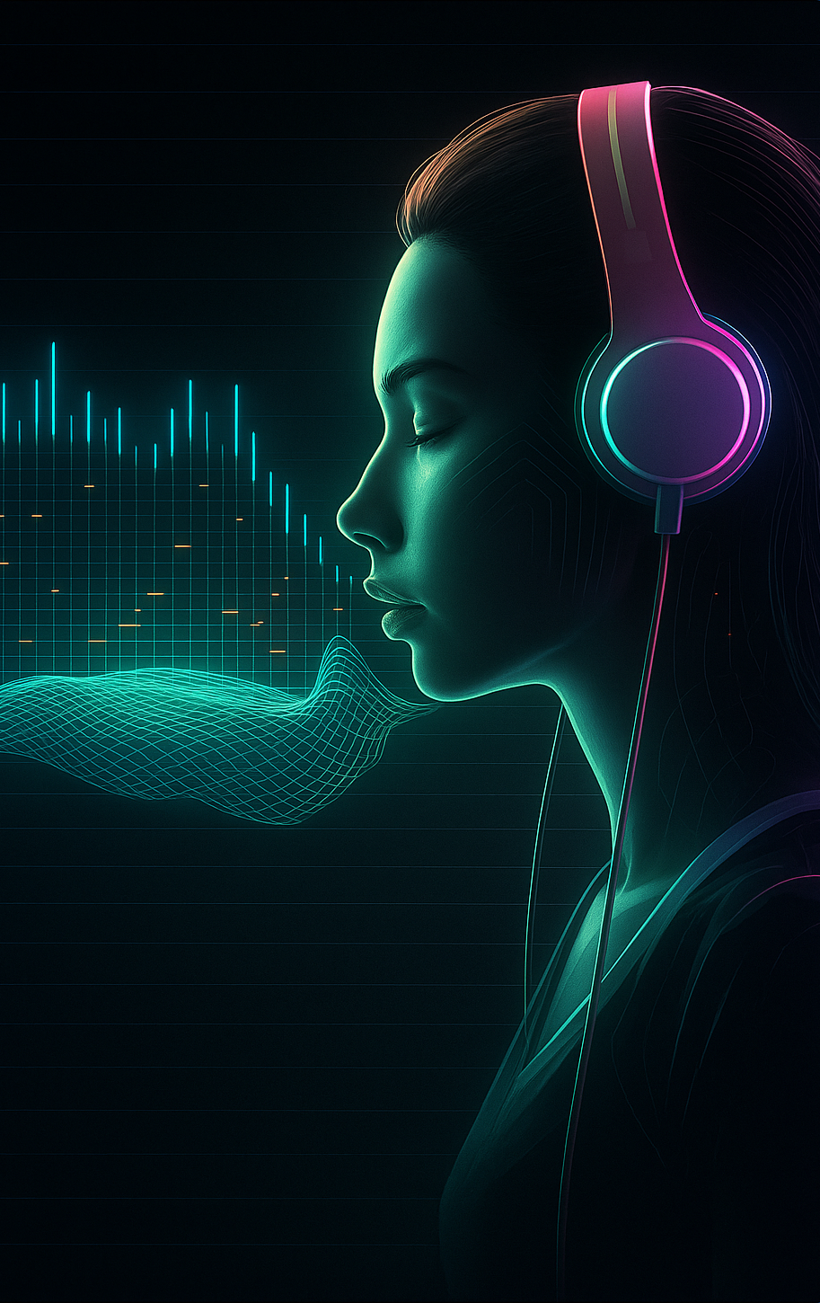
AI-Powered Urdu Conversational Agent
Group Members :
Syed Muhammad Saad
Muhammad Huzaifa
Zubair Ahmed

Slide 2
Have You Ever…
Been called by a delivery company just to confirm your order?
Received a call from a hospital to verify your appointment details?
Got a customer service call for basic inquiries or follow-ups?
These routine calls no longer need a human — they can now be handled by AI.
With Conversational AI, businesses can now automate these interactions — 24/7, reliably, and in natural Urdu speech.

Slide 3
Project Overview
AI Urdu Agent
Automation
Converses naturally in Urdu via voice and text.
Automates customer interactions for Pakistani businesses.
Multi-Channel
Integrates with calls, SMS, and web chat.

Slide 4
Core Idea & Goals
Core Idea
Primary Goals
24/7 automated support, sales, and ticketing
Fluent Urdu understanding and generation
Seamless Urdu voice and text interaction
Automate support, inquiries, appointments
Scalable and reliable under high loads
Integrate with CRM, schedulers, databases
Ensure high scalability and reliability

Slide 5

Tools & Technologies
Language Models
LLaMA , Mistral or any other closed source model
Speech to Text & Text to Speech
OpenAI Whisper, Custom Urdu STT & TTS, Google Cloud TTS
Backend & Frontend
FastAPI, Flask, React.js, Streamlit
Database & Cloud
SQL/NoSQL, Excel prototype, AWS, GCP, Azure

Slide 6





Methodology
Data Collection
Collect Urdu text and speech data.
Model Development
Fine-tune LLM and integrate STT/TTS.
Architecture
Voice→STT→LLM→TTS and text chat pipelines.
Integration
Connect CRM, scheduling tools, knowledge base.

Slide 7
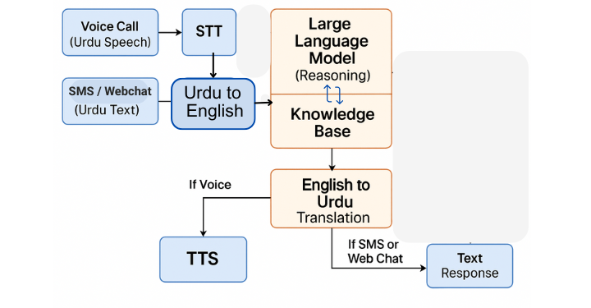
Agent Architecture
.

Slide 8




Evaluation Metrics
Latency
User Satisfaction
Response time for voice and text.
Feedback on usability and experience.
Accuracy
Correctness of understanding and response.
Scalability
Concurrent interactions handled efficiently.
2
3
1
4

Slide 9
Project Timeline & Milestones
Weeks 1–4
1
Data Collection
2
Weeks 5–14
Model Development: LLM fine-tune, STT/TTS
Weeks 15–20
3
System Integration & Architecture
4
Weeks 21–24
Business-System Integration
Weeks 25–26
5
Testing, Deployment & Monitoring

Slide 10

Expected Impact
Revolutionize Support
Scalable & Accurate
Transform Urdu customer service with AI automation.
Reliable performance under high demand.
User-Friendly
Easy and natural Urdu interactions.

Slide 11

Conclusion & Next Steps
Prototype Ready
Future Focus
AI agent prepared for pilot deployment.
Refine, test, and expand system capabilities.
Business Integration
Deploy across Pakistani business channels.

